Slide 1
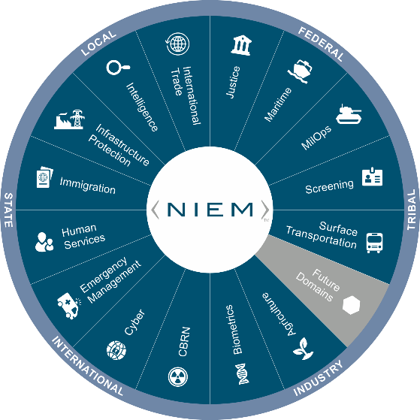
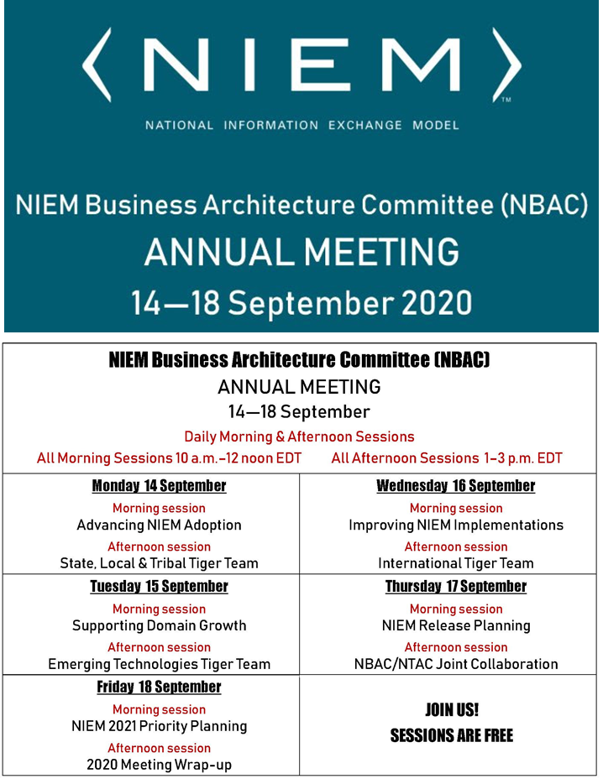

Virtual Annual Meeting (NBAC)
14 September 2020 → 1- 3PM
State, Local, Tribal Tiger Team
Cait Ryan &
Tom Carlson
SLT_TT Co-Chairs

Slide 2
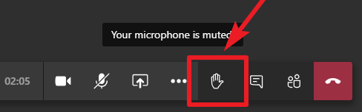

Making the most of OUR sessions
PLEASE:
MUTE your mic when you’re not talking
Identify yourself before you start to speak
Speak clearly
Disable “call waiting” feature (the clicking noise can be heard by all)
Please note: All 2020 sessions are audio recorded for NIEM training & communications purposes
QUESTIONS & ANSWERS ARE ENCOURAGED!
To signal you want to contribute without interrupting the speaker
Enter comments via CHAT window at any time
To signal a question or respond to a question
Click on ‘Raise your hand’ button on meeting toolbar
(Lower hand after you’ve talked by clicking hand button again)
All session briefings are available on NIEM’s GitHub for download as they occur
https://github.com/NIEM/NIEM-Annual-Meetings/tree/master/2020

Slide 3
AGENDA
5 MIN Introductions
20 MIN SLT TT Overview/Status Update
50 MIN Eric Sweden Presentation- State of the States
40 MIN Brainstorm and Open Discussion
5 MIN Closing Remarks

Slide 4
It all Started HERE…
At last year’s NBAC an action item was taken to resurrect the State, Local and Tribal Tiger Team.
In April Cait and Tom volunteered as co-chairs
A charter was socialized and approved by the NIEM MO in May
The first meeting of the State, Local, and Tribal Tiger Team was held June 5th.

Slide 5
Charter, Goals and Deliverables
Charter: http://niem.github.io/community/slt/charter
Goals:
Grow SLT participation in NIEM
Support SLT Community with Interoperability requirements
How:
Educate SLT community about NIEM History/Purpose in support of SLT
Marketing
Outreach Events
1:1 Meetings
Invite to meetings
Demonstrate how NIEM achieves interop
- NIEM Virtual Road Show
Encourage participation in domains, NTAC and SLT TT

Slide 6





Deliverables
Charter
Tiger Team
GitHub Page
Marketing Materials
Outreach Opportunities Tracker
Grant Assistance
NIEM User Conference
Notes:
The most important deliverables that can be addressed over the next 90 days are:
The production of an Outreach Opportunity List that will help us to identify conferences, meetings, symposiums that the tiger team should attend and/or present at.
The production of marketing materials tailored to the needs of the Tiger Team and the audience it is trying to reach.
Provide assistance to organizations with grant application and execution assistance.
The development of a “NIEM Virtual Roadshow”

Slide 7

Success Metrics
New NIEM Participants
New SLT individuals joining COI Discussions
New SLT individuals inquiring about Domains
New SLT Individuals joining Domains
New SLT TT Members
# of Speaking Engagements for TT
Representation from all 50 States
Notes:
Success will be measured and tracked based on these criteria.

Slide 8
Marketing and Messaging
Benefit to States, Local, and Tribal
Benefit to NIEM
Min. effort; Max. Results
NIEM comes from SLT info exchanges
Is a tool for creating information exchanges
Gain insight into SLT requirements
Grow NIEM domains
Grow data model
NIEM fulfills its mission

Slide 9
Updates to Executive Briefing
Changes Made
Feedback from TT
Toned down DHS and DoD content
Added additional “value add” material from earlier versions
Accentuate the value added
Decrease development time
Increase Consistency
Real-world use cases
Simplify/remove tech details
Supports a Range of Users
not limited to industry
Wider scope
Being able to see the “whole picture” of an organization through data mapping

Slide 10
State of the States: Perspectives on The power of data Eric Sweden

Slide 11

How do we effectively state The Value of NIEM. What is NIEM’s role in a COVID-19 world?
Brainstorming Session
This Photo by Unknown Author is licensed under CC BY

Slide 12
Brainstorming: Value of NIEM- Details and Examples
Decrease Development Time
Increase Consistency
Why Is this important? How does it do that over other ”solutions”?
What are some examples of this?

Slide 13
Brainstorming: Value of NIEM- Details and Examples
Range Of Users
Data Mapping
Tribal, Local, State, Federal, Private Sector, Territorial and International
Why is this important? What are the highest profile use cases or exchanges
View whole picture of an organization; increase operational awareness

Slide 14
Brainstorming: EVOLVED role of NIEM
How should NIEM be used to support this new COVID world?

Slide 15

Send comments, feedback, additional ideas to Tom and Cait
Provide 5-10 Points of Contacts and list them on our Outreach Spreadsheet under the “Organization” tab.

Slide 16
Resources
NIEM SLT TT Home
http://niem.github.io/community/slt/
Roster
https://docs.google.com/spreadsheets/d/1eUA8L05mSyz87EJyWLvIYWxLSxKr_ZCjQbFgn-6u1j8/
Outreach Opportunity Register
https://docs.google.com/spreadsheets/d/13PlQG7Z-Q4G1zEo01QzZEhG92Jt0FK6z2Z6HHfMQQDU/edit?usp=sharing

Slide 17

Thoughts?
Co-Chair- Cait Ryan, caitcryan@irishealthsolutions.com
Co-Chair- Tom Carlson, tom@tomcarlsonconsulting.com

Slide 18
NBAC Annual Meeting SESSION schedule
Session Date & Time |  | Session Topic | Planned Speakers | Facilitators
1 | Monday, 14 Sept 10 a.m. – Noon EDT | Advancing NIEM Adoption | Kshemendra Paul NIEM Executive Steering Council | Kamran Atri Thomas Krul
2 | Monday, 14 Sept 1 – 3 p.m. EDT | State, Local, Tribal Tiger Team | Eric Sweden National Association of State Chief Information Officers (NASCIO) | Cait Ryan, Tom Carlson Thomas Krul
3 | Tuesday, 15 Sept 10 a.m. – Noon EDT | Supporting Domain Growth | Brian Gattoni DHS CISA CTO | Kamran Atri Thomas Krul
4 | Tuesday, 15 Sept 1 – 3 p.m. EDT | Emerging Technologies Tiger Team | Syed Mohammed Director, US Department of Homeland Security, Modeling and Simulation Technology Center | Jalal Mapar Lain McNeill
5 | Wednesday, 16 Sept 10 a.m. – Noon EDT | Improving NIEM Implementation | Jon Kirk, Patrick Lagioia Treasury Board of Canada | Thomas Krul Kamran Atri
6 | Wednesday, 16 Sept 1 - 3 p.m. EDT | International Tiger Team | Poewan Lau | Thomas Krul Kamran Atri
7 | Thursday, 17 Sept 10 a.m. – Noon EDT | NIEM Release Planning | Working Session | Christina Medlin Web Roberts
8 | Thursday, 17 Sept 1 - 3 p.m. EDT | NBAC/NTAC Collaboration Planning | Working Session | Kamran Atri , Webb Roberts Thomas Krul, Scott Renner
9 | Friday, 18 Sept 10 a.m. – Noon EDT | NIEM 2021 Priority Planning | Stuart Whitehead NIEM Executive Director | Katherine Escobar Stephen Sullivan
10 | Friday, 18 Sept 12 -12:15 p.m. | Annual Meeting 2020 Wrap-up |  | Kamran Atri Thomas Krul Stephen Sullivan

